Slide 1
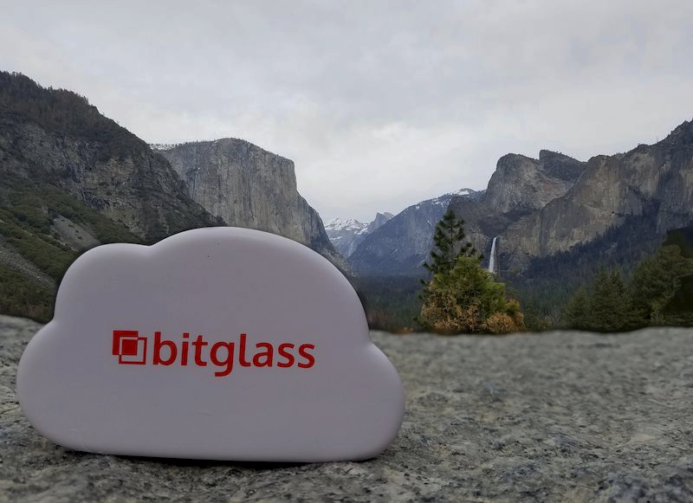
Bitglass QA
We find, report, and prevent product issues
using our minds, hands, and hearts

Slide 2
QA Roadmap 2017 - What we planned and requested last year
Product quality
Find and apply ways to measure software quality
More details in bug reports
More unit tests!! Developers to monitor their tests regularly
Code push and patch discipline
Automate everything!!!
Stories and Specs
Use cases in story specs!
Release story acceptance criteria
Always up to date specs
Bumps ahead!
Environments and Builds
Inter team communication
Stable build runs
VPC == PROD (pre-vpc)
Speed up build runs!
No errors on branch switch
Brown bag meetings (Lunch and Learn)
Bring back the team hosted events - fun beer busts

Slide 3
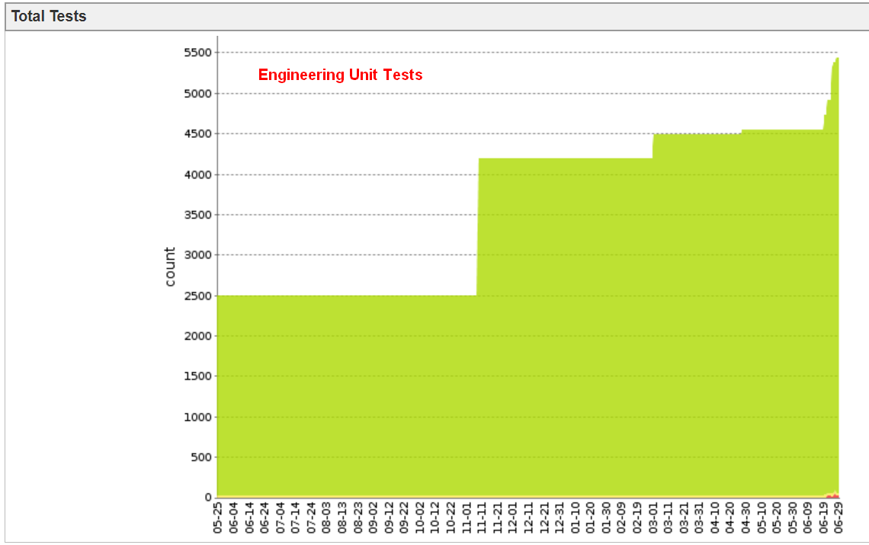
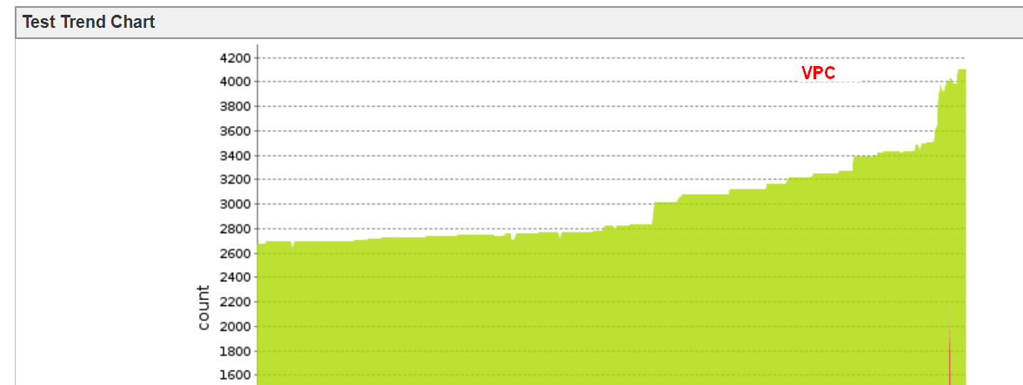
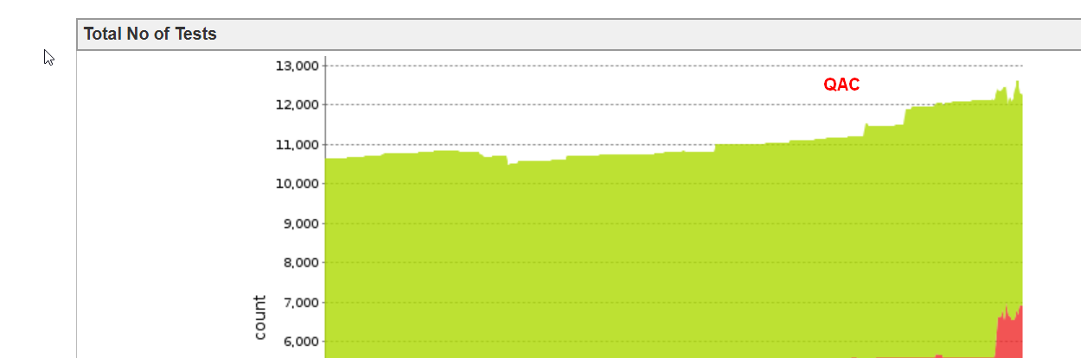


Where we are in 2018
Product quality
More unit tests!! Developers to monitor their tests regularly |  | The number of unit tests more than doubled
Automate everything!!!
More details in bug reports
Code push and patch discipline
Find and apply ways to measure software quality |  | No real progress
Notes:
Screenshots, logs, Charles reports

Slide 4
Where we are in 2018
Stories and Specs
Use cases in story specs! |  | No progress – not more than a year back
Release story acceptance criteria |  | Exit criteria are normally used in story specs
Always up to date specs

Slide 5
Where we are in 2018
Environments and Builds
Stable build runs |  | Overall it got better, but we still run into dependency issues which cause multiple build failures
VPC == PROD (pre-vpc) |  | VPC has 2 banks now
Speed up build runs!
No errors on branch switch

Slide 6

Where we are in 2018
Interteam communication
Brown bag meetings (Lunch and Learn) |  | Tech talks!
Bring back the team hosted events - fun beer busts |  | No team hosted events since 2015

Slide 7
QA Roadmap 2018
Product quality
Find and apply ways to measure software quality
More unit tests with code coverage measurement
Automate everything – use new automation tools: Sikuli, Appium
Environment monitoring and analyzing results
New UI testing and automation
Stories and Specs
Use cases in story specs!
Consider product usability and user friendliness
Design documents for backend
Bumps ahead!
Environments and Builds
On time releases
Stable build runs
VPC == PROD (2nd region)
Speed up build runs!
Container-based technology
Inter team communication
Bring back the team hosted events - fun beer busts

